Slide 1

Introduction to Machine Learning (ML)
T.K.Senthil Kumar
ML / DS Trainer in Python

Slide 2
Outline & Content
What is machine learning?
Learning system model
Training and testing
Performance
Algorithms
Machine learning structure
What are we seeking?
Learning techniques
Applications

Slide 3
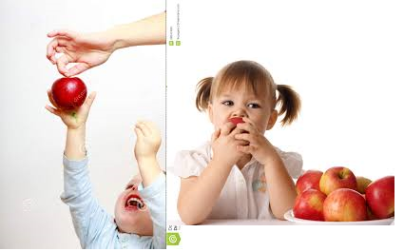
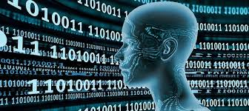
Machine Learning
Machine Learning: Field of study that gives computers the ability to learn without being explicitly programmed.
A computer program is said to learn from experience E with respect to some task T and some performance measure P, if its performance on T, as measured by P, improves with experience E.
How Human Learn and How Machine will Learn ?

Slide 4
Learning system model
Testing
Input Samples
Learning Method
System
Training

Slide 5
Algorithms
The success of machine learning system also depends on the algorithms.
The algorithms control the search to find and build the knowledge structures.
The learning algorithms should extract useful information from training examples.

Slide 6
Algorithms
Supervised learning
Unsupervised learning
Semi-supervised learning

Slide 7
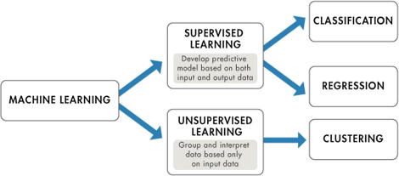
Prediction Algorithms

Slide 8
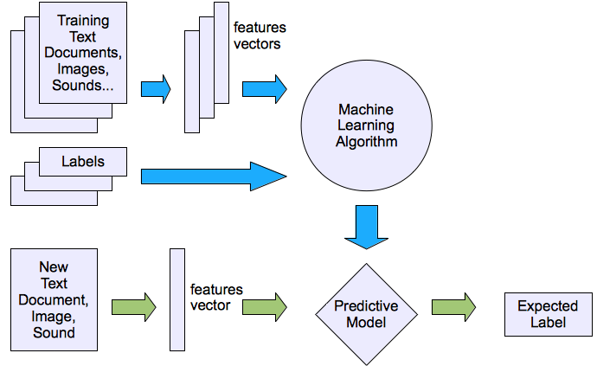
Machine learning structure
Supervised learning

Slide 9
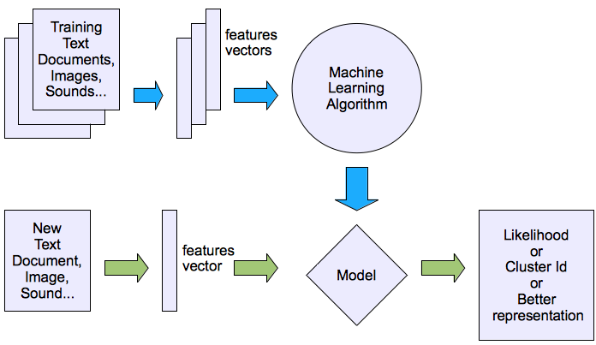
Machine learning structure
Unsupervised learning

Slide 10
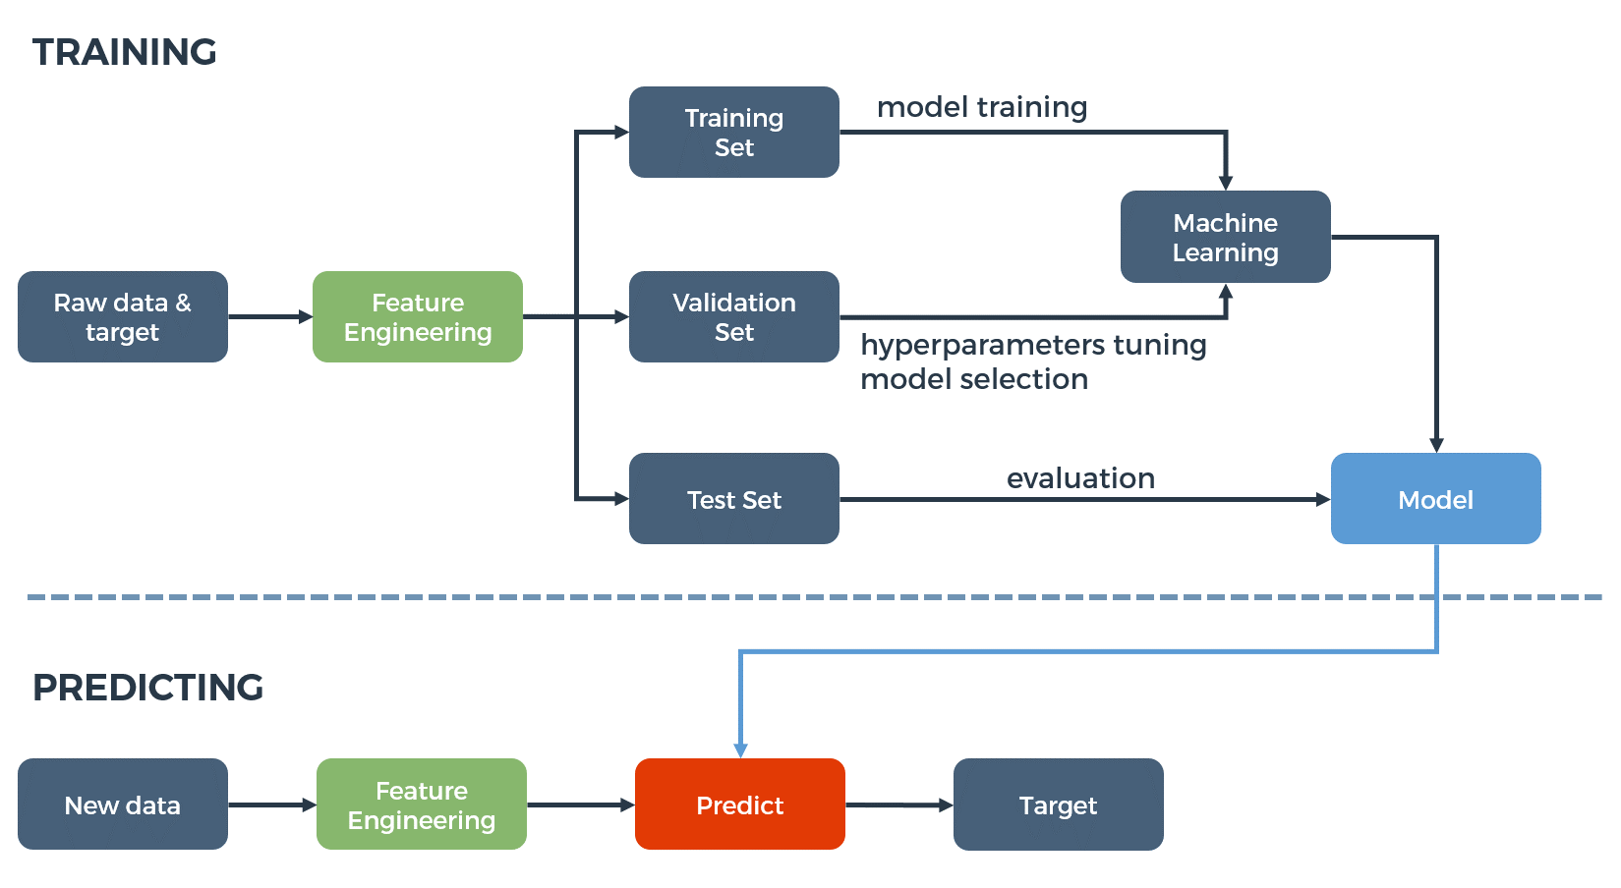
Training Vs Testing

Slide 11
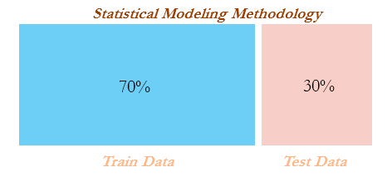
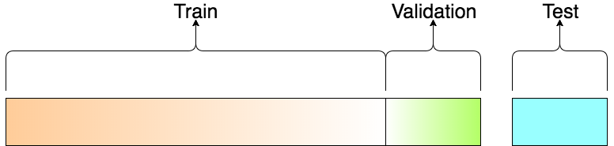
Train – Test Split

Slide 12
Train – Test Split

Slide 13
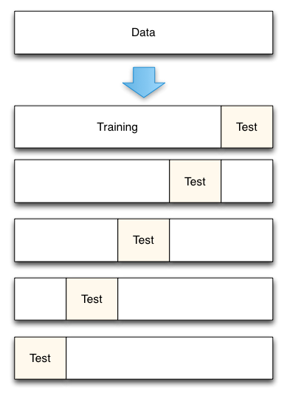
Train – Test Split

Slide 14
Use Cases
Data Security - Kaspersky | Security – Face Identification
Financial Trading – Share Market | Healthcare - Medicision
Marketing Personalization - Amazon | Fraud Detection - Paypal
Recommendations - Netflix | Online Search - Goole
Natural Language Processing (NLP) – OK Google, SIRI, Eree | Smart Cars - IBM

Slide 15
Data is the Key for ML
Everything that exists around us is data. And it’s raw, unstructured, bad, incomplete, large.
How Python can tackle all of them ?
Want to work with images — numpy, opencv, scikit
Want to work in text — nltk, numpy, scikit
Want to work in audio — librosa
Want to solve machine learning problem — pandas, scikit
Want to see the data clearly — matplotlib, seaborn, scikit
Want to use deep learning — tensorflow, keras, pytorch
Want to do scientific computing — scipy
Want to integrate web applications — Django, Flask

Slide 16

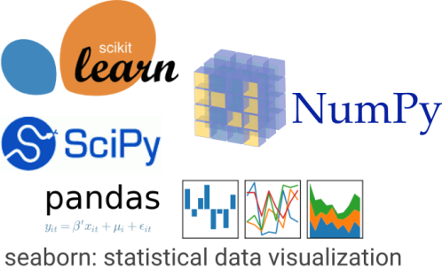
Work Flow of ML/DS
Loading the input
Data Cleaning
Data Normalization
Data Visualization
Data Reduction
Prediction
Performance Metrics
Parameter Tuning

Slide 17
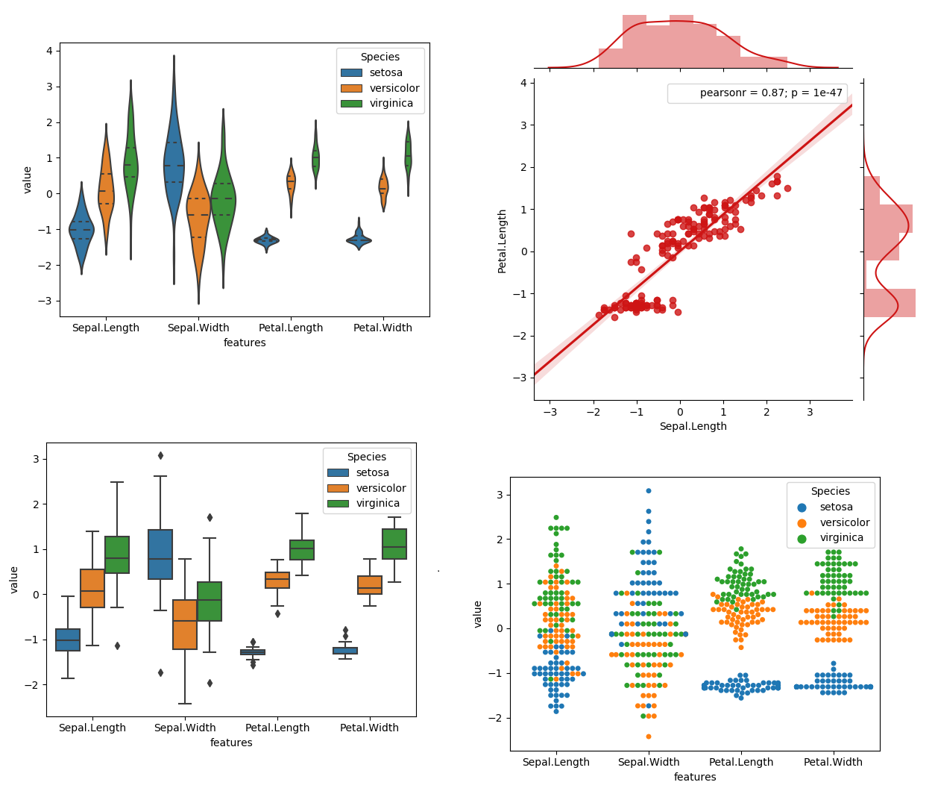
Data Visualization

Slide 18
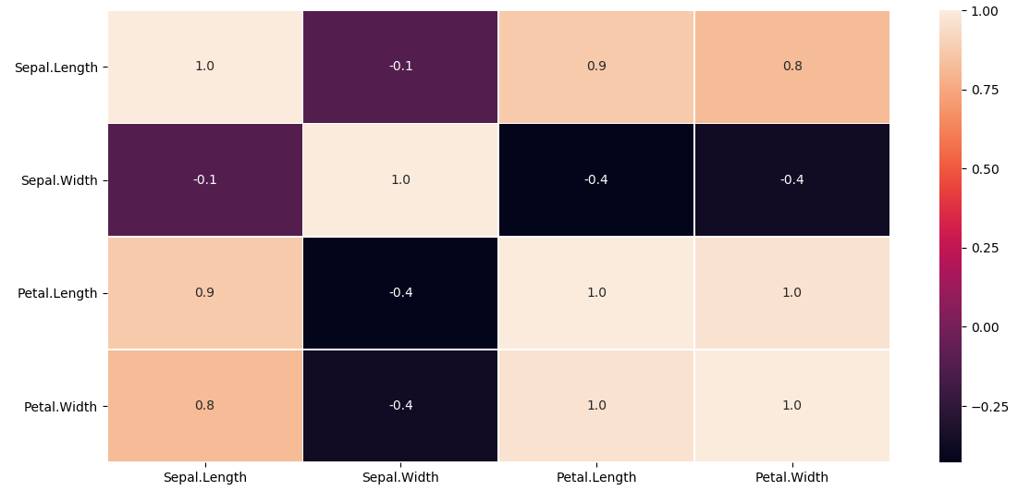
Feature Reduction
sb.heatmap(feature.corr(), annot=True, linewidths=0.5, fmt= '.1f')

Slide 19
Test Your Understanding
Which ONE of the following are regression tasks?
A) Predict the age of a person
B) Predict the country from where the person comes from
C) Predict whether the price of petroleum will increase tomorrow
D) Predict whether a document is related to science

Slide 20
Test Your Understanding
Which of the following is a supervised learning problem?
A) Grouping people in a social network.
B) Predicting credit approval based on historical data
C) Predicting rainfall based on historical data
D) all of the above

Slide 21
Test Your Understanding
Which of the following are classification tasks?
A) Find the gender of a person by analyzing his writing style
B) Predict the price of a house based on floor area, number of rooms etc.
C) Predict whether there will be abnormally heavy rainfall next year
D) Predict the number of copies of a book that will be sold this month

Slide 22
Test Your Understanding
Which of these are categorical features?
A) Height of a person
B) Price of petroleum
C) Mother tongue of a person
D) Amount of rainfall in a day

Slide 23
Test Your Understanding
I am the marketing consultant of a leading e-commerce website. I have been given a task of making a system that recommends products to users based on their activity on Facebook. I realize that user-interests could be highly variable. Hence I decide to
a. First, cluster the users into communities of like-minded people and b. Second, train separate models for each community to predict which product category (e.g. electronic gadgets, cosmetics, etc.) would be the most relevant to that community.
The first task is a/an ______________ learning problem while the second is a/an ________________ problem. Choose from the options:
A) Supervised and unsupervised
B) Unsupervised and supervised
C) Supervised and supervised
D) Unsupervised and unsupervised

Slide 24
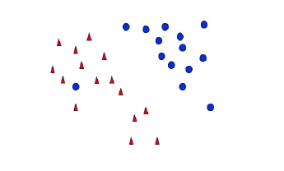
Test Your Understanding
What would be the ideal complexity of the curve which can be used for separating the two classes shown in the image below?
A) Linear
B) Quadratic
C) Cubic
D) insufficient data to draw conclusion

Slide 25
THANK YOU

